Slide 1

Garbage Collection and useful utility classes
Pradeep LN

Slide 2
Unit 7 Objectives
GC and other utility classes
Garbage Collection
Invisible objects vs. unreachable objects
Finalizers
The String class
Splitting strings
Internalization
StringBuffer and StringBuilder
Wrapper classes
Auto boxing / unboxing
System class
Date and Calendar
Understanding Enumerated Types
Stateful and Behavioral Enumerations

Slide 3
Garbage Collection
GC and other utility classes
All objects occupy memory on the heap.
Every „new‟ operation results in a new memory allocation on the heap
Java performs automatic garbage collection periodically, returning an object's memory to the system for future use
In Java, we don't have to free the memory used by an object.
The garbage collector runs periodically in the background and cleans up unreferenced objects.

Slide 4
Automatic Garbage Collection
GC and other utility classes
Automatic garbage collection has many
advantages
Eliminates the well-known problems of dangling pointers and memory leaks
With many efficient garbage collection algorithms that have evolved over a period of time, memory leaks can be minimized to a large extent
How does the GC work
Increases reliability
?
Results in code that is free of memory related bugs, which are generally very difficult to debug.

Slide 5


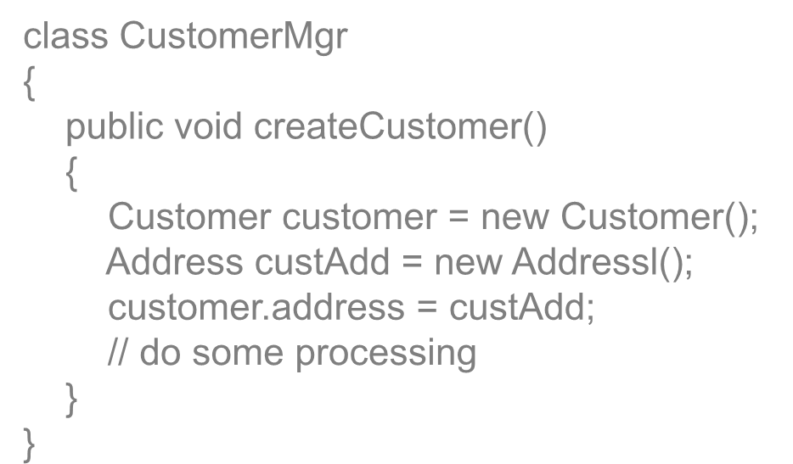
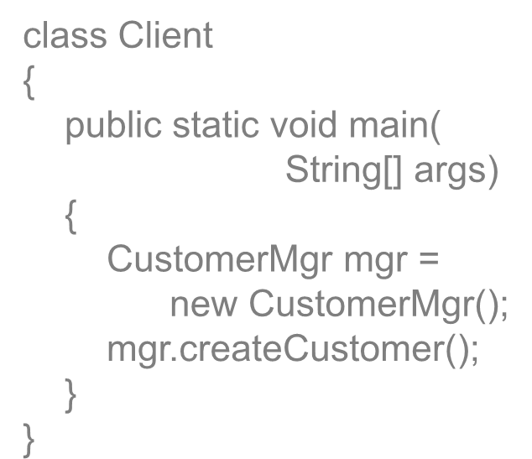
Understanding Garbage Collection
GC and other utility classes
The GC goes about claiming memory
occupied by unreachable objects.
An object enters an unreachable state when no more strong references to it exist.
class CustomerMgr
{
public void createCustomer()
{
Customer customer = new Customer(); Address custAdd = new Addressl(); customer.address = custAdd;
// do some processing
}
}
class Client
{
public static void main(
String[] args)
{
CustomerMgr mgr = new CustomerMgr();
mgr.createCustomer();
}
}

Slide 6
Understanding Garbage Collection
GC and other utility classes
CustomerMgr createCustomer()
What happens when method createCustome r terminates?
main() createCustomer()
Customer
Address
Customer and Address objects go out of scope, that is, they become unreachable to the piece of code
These objects become eligible for garbage collection

Slide 7
Understanding Garbage Collection
GC and other utility classes
Automatic garbage collection does not necessarily mean removing all memory management responsibility from the application developer.
It is most widely misunderstood this way
Application developers are required to follow good memory management techniques like setting references to null, once they are done with working with the objects.
Lack of this conviction may result in „invisible objects‟ being created and may lead to unintentional object retention.

Slide 8
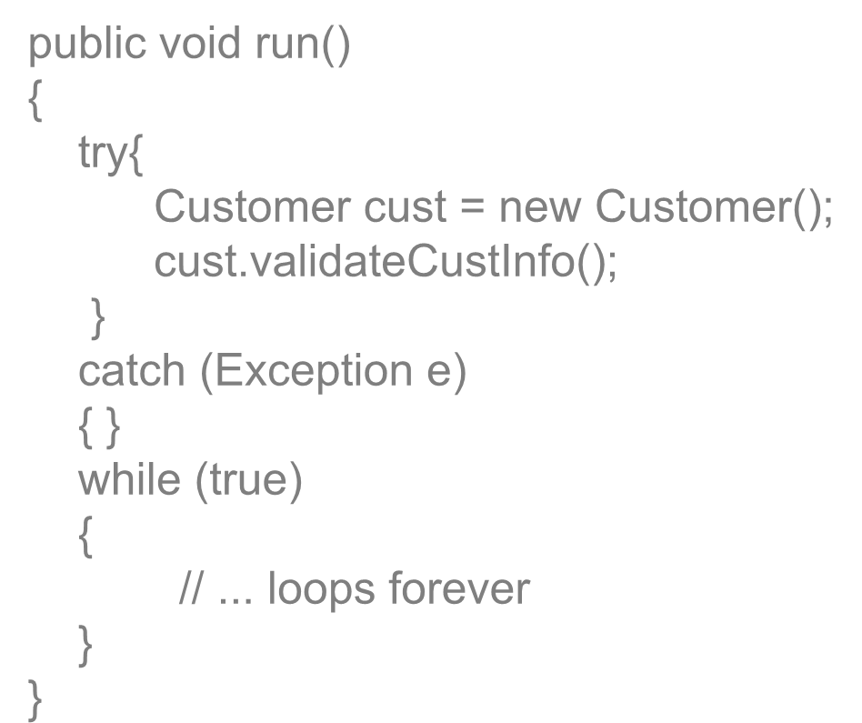

Invisible Objects
GC and other utility classes
Invisible objects are a result of programs „holding on‟ to a reference, which is no longer required.
Refer to the below code segment that causes an invisible object that is escapes garbage collection
public void run()
{
try{
Customer cust = new Customer();
cust.validateCustInfo();
}
catch (Exception e)
{ }
while (true)
{
// ... loops forever
}
}
What happens to object cust once the „try‟ block terminates

Slide 9
Understanding Garbage Collection
GC and other utility classes
While object cust is inaccessible outside the try block, it does not still become an eligible candidate for garbage collection
Only when run() method terminates, does stack unwinding happen and the cust object becomes unreachable
As a good programming practice, always remember to set references that are no longer required to „null‟
This will enable the garbage collector to reclaim memory

Slide 10
Invoking Garbage Collector
GC and other utility classes
Garbage collector can be invoked by invoking the
method System.gc()
The request may or may not be honored
There is no guarantee of desired memory being reclaimed.
The JVM specification does not lay down strict rules about how garbage collection needs to be perfomed
A rigidly defined garbage collection model might be
impossible to implement on all platforms
It is optimized differently by different vendors
See Listing : GCTest.java

Slide 11
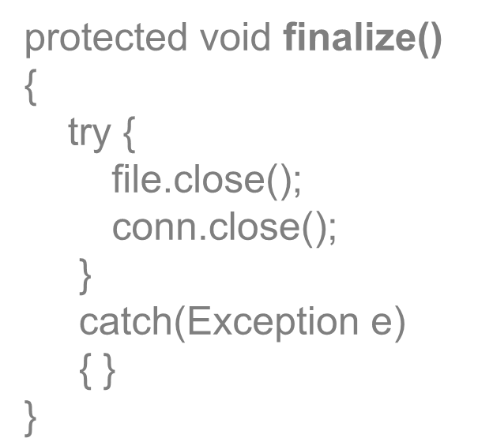

Performing cleanup
GC and other utility classes
Garbage collection only reclaims unused memory, while system resources used by the program need to be released by the developer.
Every class can include the finalize() method, which is invoked (if defined) just before object destruction.
This presents an opportunity to perform cleanup of any special allocations made by the program.
protected void finalize()
{
try {
file.close();
conn.close();
}
catch(Exception e)
{ }
}

Slide 12
The String Class
GC and other utility classes
Management of Data comprising of multiple characters can be
done through String Object.
String
String() String(String str);
Length():int
equals(String str): boolean Concat(String str): String
Value Length
Once a String object has been created, neither its value nor its length can be changed, String objects are immutable

Slide 13
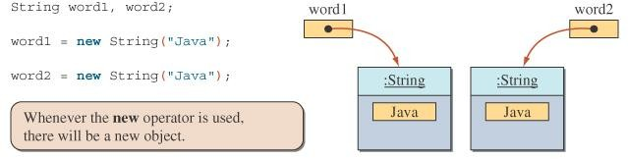
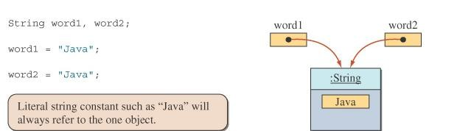
GC and other utility classes
Strings are immutable
We can do this because String objects are immutable.

Slide 14
String object
GC and other utility classes
Different ways of creating Strings
String str;
str = new String(“hello”); String str2 = new String(str); String literal = “hello”;
String
Value =“hello” Length =5;
The String class has overloaded constructors to support different ways of object creation.
The class String includes methods for examining : individual characters of the sequence, comparing strings,
searching strings, extracting substrings, creating a copy of a string

Slide 15
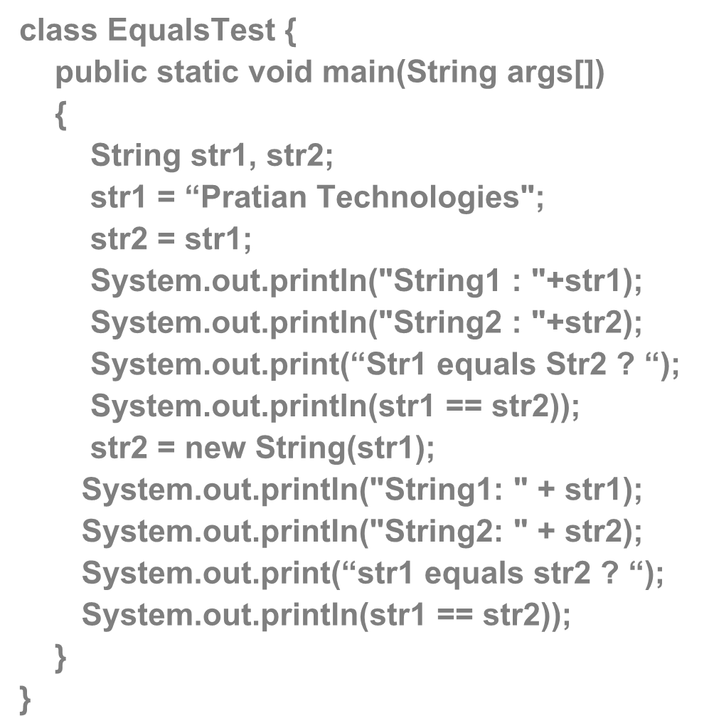

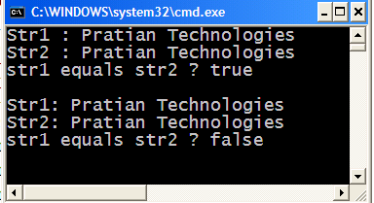
GC and other utility classes
String Equality
class EqualsTest {
public static void main(String args[])
{
String str1, str2;
str1 = “Pratian Technologies"; str2 = str1;
System.out.println("String1 : "+str1); System.out.println("String2 : "+str2); System.out.print(“Str1 equals Str2 ? “); System.out.println(str1 == str2));
str2 = new String(str1);
System.out.println("String1: " + str1); System.out.println("String2: " + str2); System.out.print(“str1 equals str2 ? “); System.out.println(str1 == str2));
}
}
What is the output ?
Notes:
T
T
T
F

Slide 16
String Equality
GC and other utility classes
▪ == merely checks if the two references are equal,
that is, pointing to the same object in memory.
It does not check if the actual contents of the String objects are equal
Comparison of String objects is done by invoking the equals method of String class
public boolean equals(Object obj)
String class overrides the equals() method of class Object.
public boolean equalsIgnoreCase(String str)
Ignores case while comparing the contents
Notes:
== merely checks if the two references are equal, that is, pointing to the same object in memory.: It is not true…..

Slide 17
String Concatenation
GC and other utility classes
String concatenation is done by using the „+‟
operator
String class also provides a method
String concat(String str)
Concatenates the specified string to the string.
end of this
String lastName = “Gandhi";
String name = new String(“Mohandas" + “KaramChand "+ lastName); System.out.println(“Mahatma".concat(lastName));

Slide 18
Converting to String
GC and other utility classes
The String.valueOf() method is a class method that provides the
„String‟ representation of primitive types and objects.
public static String valueOf(int integerLiteral)
Overloaded methods for all primitive types
Overloaded method that takes an Object as argument
String number = String.valueOf(128); String truth = String.valueOf(true); String bee = String.valueOf('B'); String pi = String.valueOf(Math.PI);
// Creates "128"
// Creates "true"
// Creates "B“
// Creates "3.14159"

Slide 19
Converting to String
GC and other utility classes
Any primitive value or object that is concatenated with a string is
converted to String
“Hello”.concat(str.toString());
String str =“World”
String greeting =“Hello” +str String str2 = “Cloud”+ 9
“Cloud”.concat(String.valueOf(9));
Notes:
Yes, but if in first place numeric are there with operator it will perform the operation …but not after string…like
String s8 = "$java "+1+5+" abc"; //$java 15 abc
String s9 = 10+16 +"java"; //26java
String s10 = "java"+ 12+10; //java1210

Slide 20
Manipulating Character Case
GC and other utility classes
String class provides the following methods
to manipulate character case in String.
String toUpperCase() String toLowerCase()
Original String object is returned if none of the characters, is changed, otherwise new String object is constructed and returned.

Slide 21
String Indexing
GC and other utility classes
Strings are indexed, starting at 0.
0 1 2 3 4 5 6 7 8 9 10 11 12
M A H A T M A G A N D H I
String class provides methods to search for a specific character inside the string object.
If the search is successful, then the index of the char is returned, otherwise -1 is returned.
int indexOf(int c)
Returns the index of first occurrence of the
argument char.
int indexOf(int c, int fromIndex)
Finds the index of the first occurrence of the argument character in a string, starting at the index specified in the second argument.
int indexOf(String str)
Finds the start index of the first occurrence of the substring argument in a String.

Slide 22
Sub Strings
GC and other utility classes
String class provides methods
to extract
specified portion of the given String.
String substring(int startIndex)
String substring(int startIndex, int endIndex)
A new String object containing the substring is created and returned.
The original String will not be affected.

Slide 23
Splitting Strings
GC and other utility classes
The split() method simplifies the task of breaking a
string into substrings, or tokens.
This method takes a delimiter separated string as argument and splits the string into several tokens based on the occurrences of the delimiter (regex)
This;is a;delimiter;separated;string.
split this string based on regex “;”
strArr[0] This
strArr[1] is a
strArr[2] strArr[3] strArr[4] delimiter separated string

Slide 24
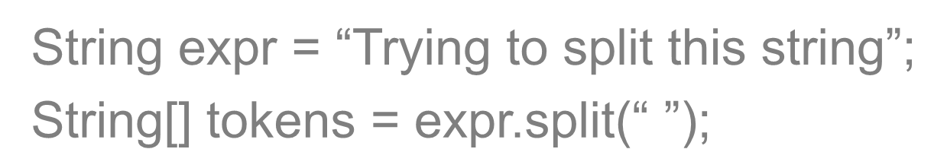

Splitting Strings
GC and other utility classes
String[] split(String regex)
Searches for a match as specified by the string argument (which contains a regular expression) and splits this string into an array of strings accordingly.
String[] split(String regex, int limit)
integer argument specifies the maximum size of
the returned array.
String expr = “Trying to split this string”;
String[] tokens = expr.split(“ ”);

Slide 25
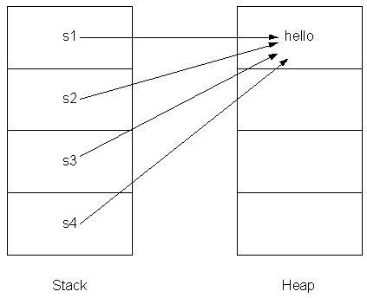
String Internalization
GC and other utility classes
The JVM maintains an internal list of references ( pool of unique String objects) for String literals in our application
To avoid duplicate String objects in heap memory.
Whenever the JVM
loads String literals from class file and executes, it checks whether that String exists in the internal list or not.
What about String objects created on the fly ?
If it already exists in the list, then it does not create a new String and it uses reference to the existing String Object.

Slide 26
String Internalization
GC and other utility classes
JVM does this type of checking internally for String literals but not for String object which it creates through 'new' keyword.
String objects occupy a lot of memory, and to optimize memory utilization, the mechanism of string internalization is adopted.
This forces JVM to check the internal list and use the existing String object if it is already present.
Interned strings avoid duplicate strings.
There is only one copy of each String that
has been
interned, no matter how many references point to it.

Slide 27
String Internalization
GC and other utility classes
String intern()
When the intern method is invoked, if the pool already contains a string equal to this object , then the string from the pool is returned. Otherwise, this object is added to the pool and a reference to this object is returned.
See Listing : StringInternTest.java
Interned Strings not only optimize memory utilization, but also ensure better performance.
See Listing : StringInternDemo.java

Slide 28
GC and other utility classes
String Methods
replace(char oldChr, char newChar) | Returns a new string resulting from replacing all occurrences of oldChar in this string with newChar.
contains(CharSeque nce s) | Returns true if the string contains the specified character sequence.
trim | Removes the leading and trailing spaces. str1.trim( )
charAt(int index) | Returns the char value at the specified index.
startsWith | Returns true if a string starts with a specified prefix string.str1.startsWith( str2 )
endsWith | Returns true if a string ends with a specified suffix string.str1.endsWith( str2 )

Slide 29
StringBuffer
GC and other utility classes
A StringBuffer is a thread-safe, mutable sequence of
characters.
A StringBuffer is like a String, but can be modified.
It contains some particular sequence of characters, the length and content of the sequence can be changed through certain method calls.
In string processing applications,
we would like to change the contents of a string.
In other words, we want it to be mutable.
See listing : StringReverse.java

Slide 30





StringBuffer
GC and other utility classes
StringBuffer word = new StringBuffer("Java"); word.setCharAt(0, 'D');
word.setCharAt(1, 'i');
word
word
: StringBuffer
word.setCharAt(0, 'D');
word.setCharAt(1, 'i');
: StringBuffer
Java
Diva
Changing a string Java to Diva
Before
After

Slide 31
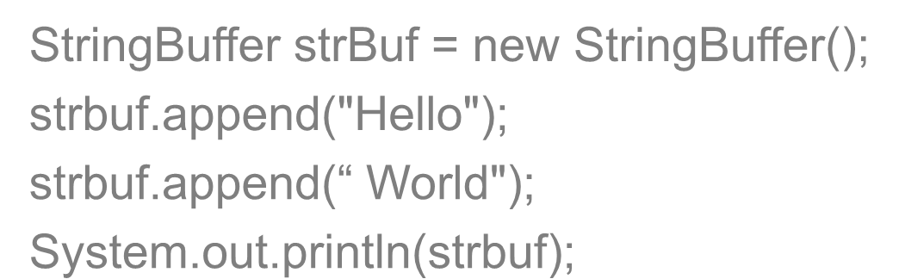

StringBuffer
GC and other utility classes
Important Methods of StringBuffer
append method
StringBuffer append(String s)
Appends the specified string to this character sequence.
StringBuffer append(StringBuffer sb)
StringBuffer append(int i)
Appends the string representation of the int argument to this sequence.
Overloaded for all primitive types
StringBuffer strBuf = new StringBuffer(); strbuf.append("Hello");
strbuf.append(“ World"); System.out.println(strbuf);

Slide 32
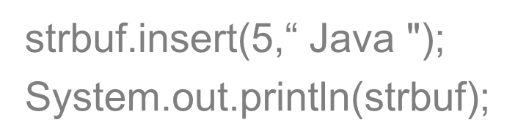

StringBuffer
GC and other utility classes
Important Methods of StringBuffer
insert method
StringBuffer insert(int offset, String str)
Inserts the string into this character sequence, at the specified position
StringBuffer insert(int offset, int i)
Inserts the string representation of the int argument into this sequence, at the specified position.
strbuf.insert(5,“ Java "); System.out.println(strbuf);
reverse()
Causes this character sequence to be replaced by the reverse of the sequence.
String toString()
See Listing : StringBufferReverse.java

Slide 33
StringBuilder
GC and other utility classes
Is a mutable version of String
Introduced in Java 5.0 (SDK 1.5)
To improve the performance of the StringBuffer class
The J2SE 5.0 javac compiler normally uses StringBuilder instead of StringBuffer whenever you perform string concatenation
StringBuilder and StringBuffer support exactly the
same set of methods
Methods of this class are not synchronized
No synchronization! Not safe for use by multiple threads

Slide 34
Wrapper classes
GC and other utility classes
Although “Everything is an object” in Java, yet we
have primitive types like int, double and so on
For improving performance, primitive types are retained in Java
Wrappers are classes that wrap up primitive values in classes
These classes offer utility methods to manipulate the values
represented by the primitives
Wrappers classes are particularly useful while working with Collections like Vector, ArrayList and others that only work with „Objects‟

Slide 35
Wrapper classes
GC and other utility classes
The java.lang package contains wrapper
classes that correspond to each primitive type:
Primitive Type
byte short int long
float double char boolean void
Wrapper Class
Byte Short Integer Long
Float Double Character Boolean Void

Slide 36
Wrapper classes
GC and other utility classes
Wrapper classes offer utility methods
to extract the primitive value from a String
to convert to other primitive types
to represent a primitive value by its wrapper
Some methods of class Integer
static int parseInt(String strNum) throws NumberFormatException
double doubleValue()
int intValue()
Returns the value of this Integer as an int.
See Listing : WrapperDemo.java

Slide 37

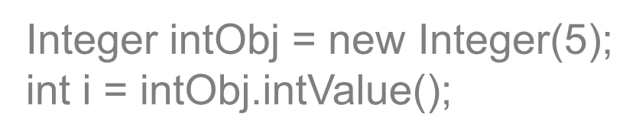
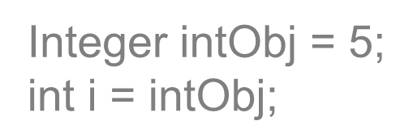
Autoboxing and Unboxing
GC and other utility classes
Java 1.5 introduces to the language the feature of autoboxing /
unboxing
Wrapper types and primitive types can now be interchangeably used
Prior to Java 1.5
explicitly wrap up primitive values into objects
Make method calls to extract primitive values from wrapper objects
Integer intObj = new Integer(5); int i = intObj.intValue();
Java 1.5 onwards, the following code works
Integer intObj = 5; int i = intObj;

Slide 38

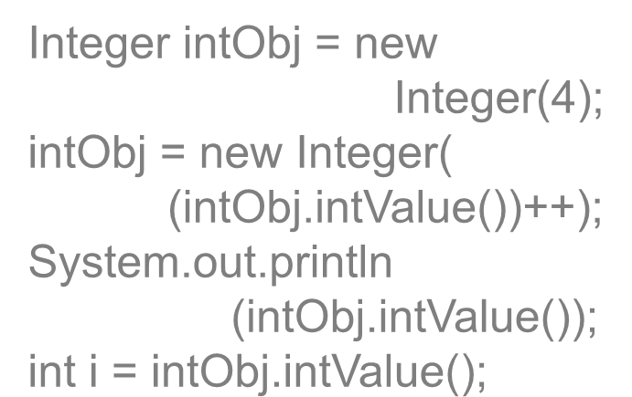

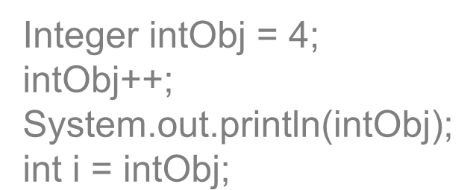
Autoboxing and Unboxing
GC and other utility classes
Autoboxing refers to the automatic storing of a value of primitive type into an object of the corresponding wrapper class.
Unboxing refers to automatic conversion of the value represented by the wrapper object to the corresponding primitive type
Integer intObj = new
Integer(4); intObj = new Integer(
(intObj.intValue())++);
System.out.println
(intObj.intValue()); int i = intObj.intValue();
Integer intObj = 4; intObj++; System.out.println(intObj); int i = intObj;
Compiler generates

Slide 39
System class
GC and other utility classes
The System class contains several useful class fields
and methods.
System class cannot be instantiated.
Has no public constructor
System class provides
Standard input stream
Standard output stream
Standard error stream
access to externally defined properties / environment variables
method to terminate the application

Slide 40
System class
GC and other utility classes
Important class fields
System.out
PrintStream to write bytes of data to the standard output device, usually the monitor
System.in
InputStream to read bytes of data from the standard input device, usually the keyboard
System.err
PrintStream to write bytes of data to the standard error device, by default is the monitor

Slide 41
System class
GC and other utility classes
Important Methods
static long currentTimeMillis()
Returns the current time in milli seconds
static void exit(int status)
Terminates the currently running Java Virtual Machine.
static void gc()
Runs the garbage collector
static void runFinalization()
Runs the finalization methods of any objects pending finalization.

Slide 42
System Properties
GC and other utility classes
System class maintains a Properties object that describes the configuration of the current working environment.
System properties are key/value pairs maintained by the System class.
Define traits or attributes of the current working environment.
When the
Java virtual machine first starts
up,the
contain
system properties are initialized to
information about the runtime environment
System class stores information like
the current user
the current version of the Java runtime
the character used to separate components of a file

Slide 43
GC and other utility classes
System Properties
KEY | VALUE
"file.separator" | Character that separates components of a file path. This is "/" on UNIX and "\" on Windows.
“java.class.path" | Path used to find directories and JAR archives containing class files.
“java.home" | Installation directory for Java Runtime Environment (JRE)
“java.version" | JRE version number
"os.name" | Operating system name
“user.dir" | User working directory
"user.home" | User home directory

Slide 44

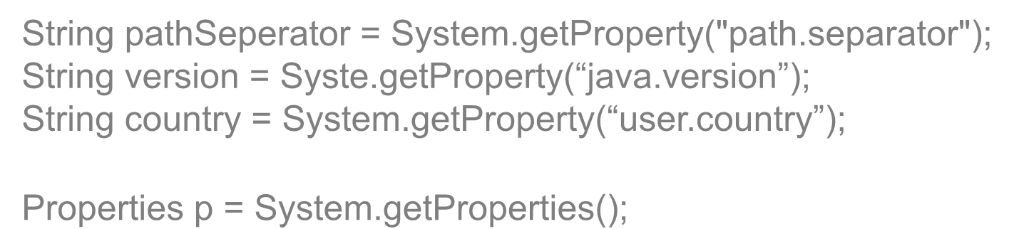
Reading System Properties
GC and other utility classes
The System class has two methods used to
read system properties
static String getProperty(String key)
Gets the system property indicated by the specified key.
static Properties getProperties()
Returns all the current system properties.
String pathSeperator = System.getProperty("path.separator");
String version = Syste.getProperty(“java.version”); String country = System.getProperty(“user.country”);
Properties p = System.getProperties();

Slide 45

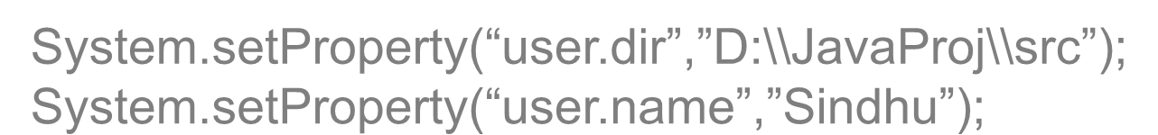
Setting System Properties
GC and other utility classes
System properties can be programmatically
modified by invoking the method
static String setProperty(String key, String value)
Sets the system property indicated by the specified key to the specified value
System.setProperty(“user.dir”,”D:\\JavaProj\\src”); System.setProperty(“user.name”,”Sindhu”);
System properties can also be set while launching the JVM, with use of the -D option java -Dlang=en MyApp
See Listing : SystemPropertiesDemo.java

Slide 46
Date & Calendar
GC and other utility classes
The Date and Calendar classes represents a specific
instance in time
These classes are in java.util package
Methods of Date class have been deprecated and replaced by methods in Calendar class
Calendar is an abstract class, whose getInstance() method can be used to get a calendar instance that represents current date and time
See Listing : DateCalendarDemo.java

Slide 47
Enumerated Types
GC and other utility classes
Java SE 5.0 allows developers to declare a type as
an „enum‟ type.
An enum type is a type whose fields consist of a fixed set of constants.
For instance, days of the week can take one of the seven legal values
This can be modeled as an enum as below
enum WEEK { SUNDAY, MONDAY, TUESDAY, WEDNESDAY, THURSDAY, FRIDAY, SATURDAY }

Slide 48

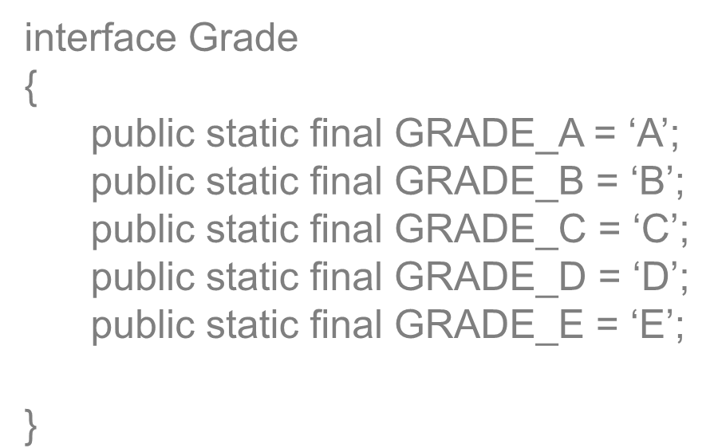
Prior to Java 1.5
GC and other utility classes
Let us suppose that a student can score one
of the five grades A, B, C, D and E
A frequent pattern in Java was the use of set of static final variables
interface Grade
{
public static final GRADE_A = „A‟; public static final GRADE_B = „B‟; public static final GRADE_C = „C‟; public static final GRADE_D = „D‟; public static final GRADE_E = „E‟;
}

Slide 49


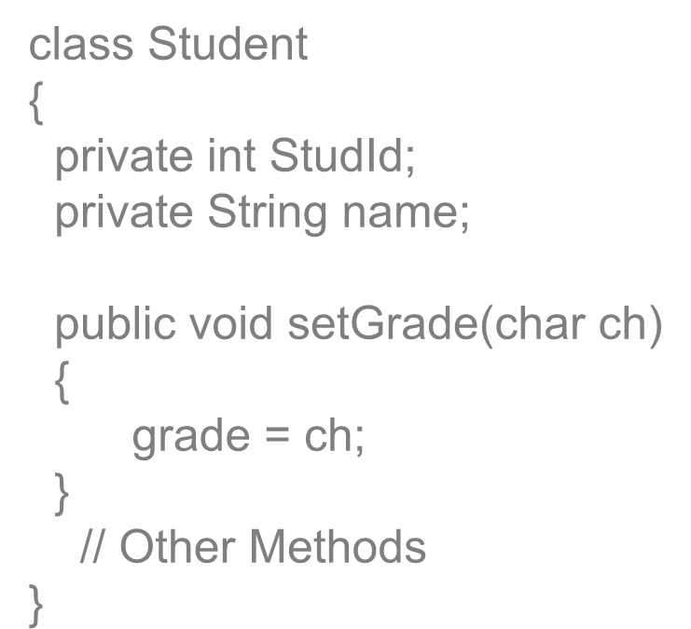
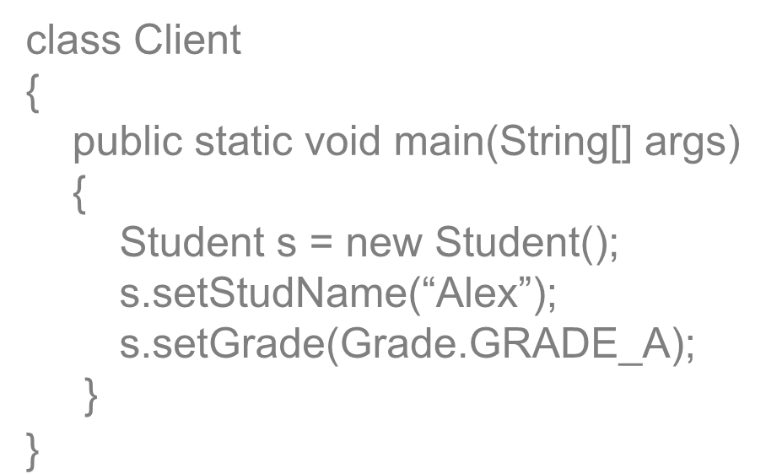


GC and other utility classes
Why Enums ?
class Client
{
public static void main(String[] args)
{
Student s = new Student(); s.setStudName(“Alex”); s.setGrade(Grade.GRADE_A);
}
}
class Student
{
private int StudId; private String name;
public void setGrade(char ch)
{
grade = ch;
}
// Other Methods
}
How do we restrict Grade
//Will the below line of code execute ?
s.setGrade(‘Z’);
to take one of the 5 permitted values only ?

Slide 50


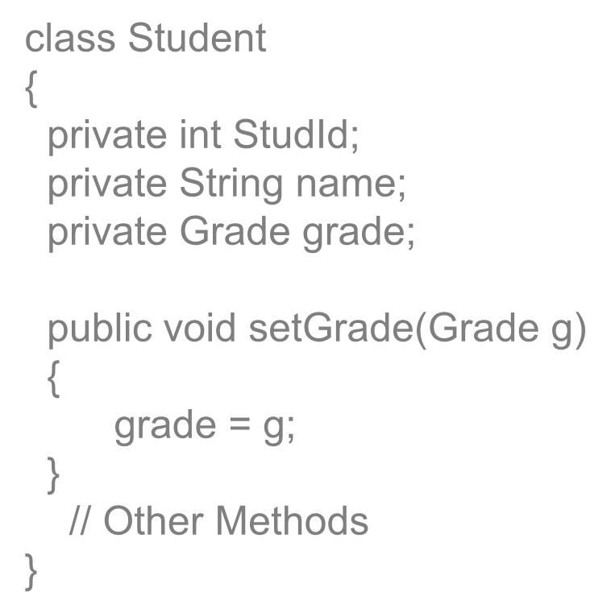


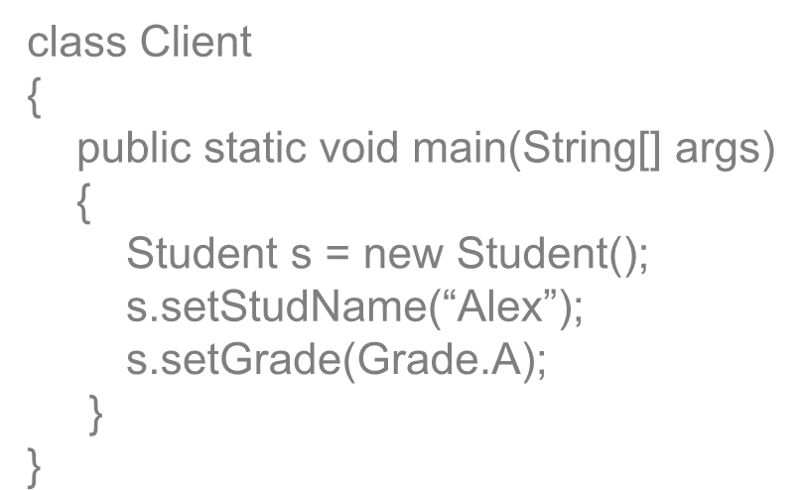
Enumerated Types
GC and other utility classes
Enum helps prevent accidentally using
an illegal value where a group of predefined constant values, and nothing else, are expected
class Student
{
private int StudId; private String name; private Grade grade;
public void setGrade(Grade g)
{
grade = g;
}
// Other Methods
}
enum Grade { A, B, C, D, E; }
class Client
{
public static void main(String[] args)
{
Student s = new Student(); s.setStudName(“Alex”); s.setGrade(Grade.A);
}
}

Slide 51
Enumerated Types
GC and other utility classes
Enums provide compile-time type safety
As enums represent constants, the names of an enum type's fields are in uppercase letters (By convention)
Enums can be used in switch-case structure
See Listing : EnumDemo.java

Slide 52
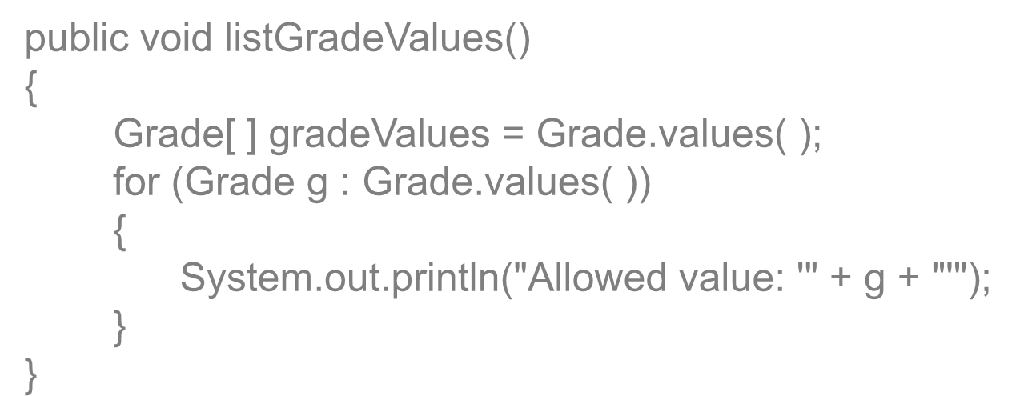

Iterating Over Enums
GC and other utility classes
The enumerated types, has built-in
method values().
This method provides access to all of the types within an enum.
public void listGradeValues()
{
Grade[ ] gradeValues = Grade.values( ); for (Grade g : Grade.values( ))
{
System.out.println("Allowed value: '" + g + "'");
}
}

Slide 53
Structural & Behavioral Enums
GC and other utility classes
The enum declaration defines a class
All enums implicitly extend java.lang.Enum.
The enum class body can include methods and other fields.
The compiler adds some methods including values() methods by default
The enum class body can include constructors as well
See Listing : Planet.java

Slide 54

GC and other utility classes
Question time

